Slide 1
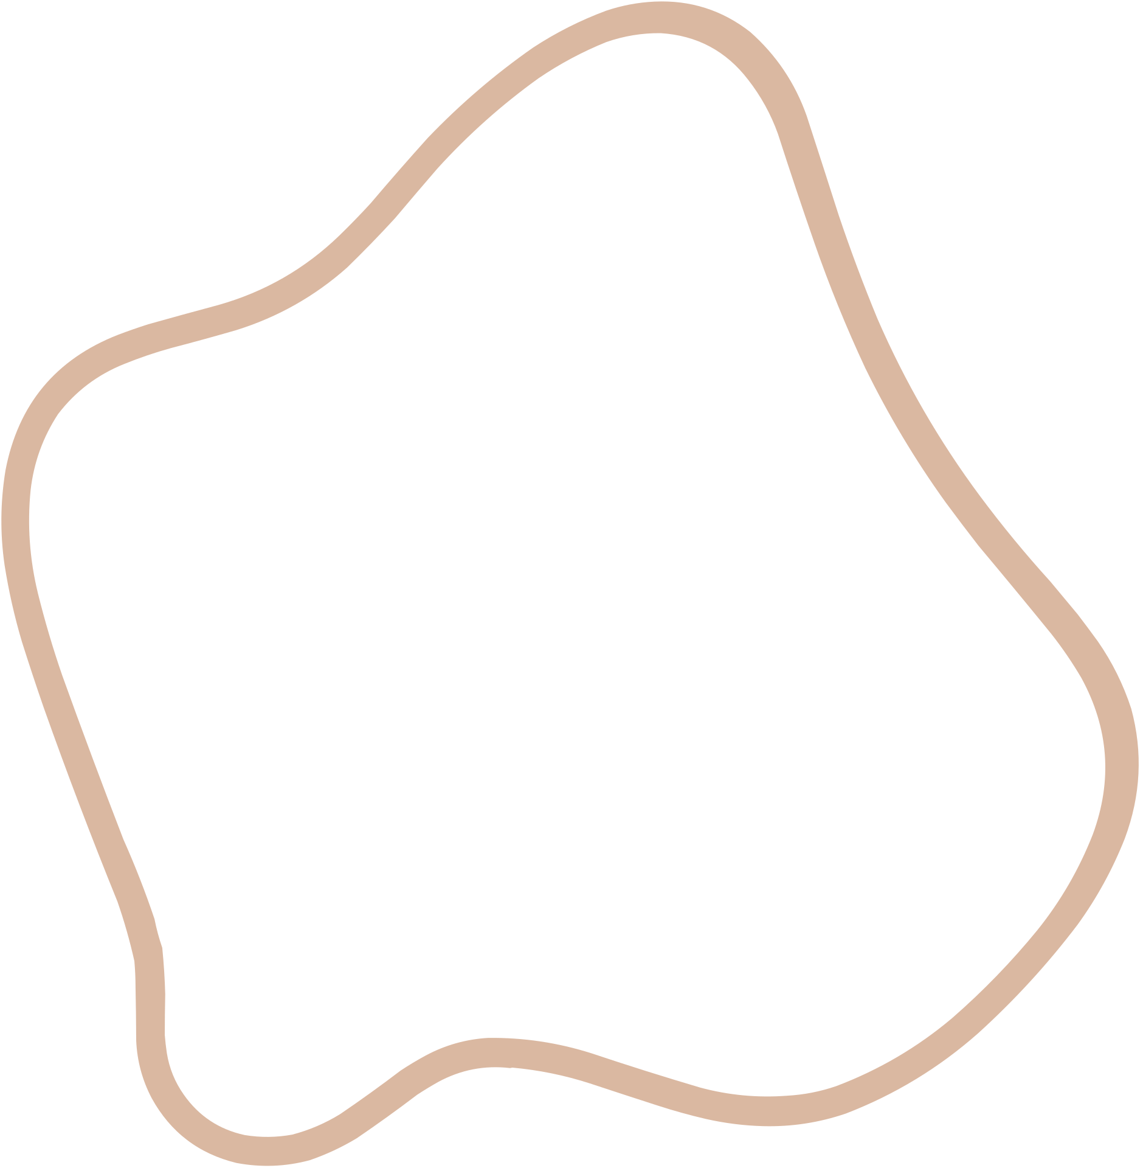

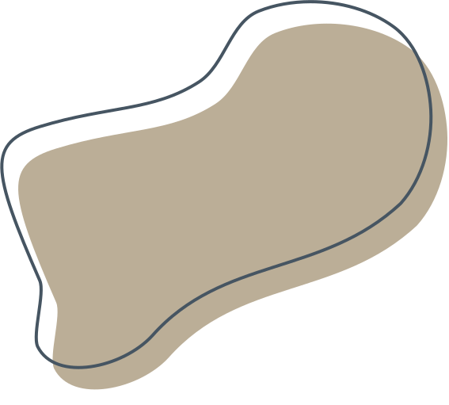

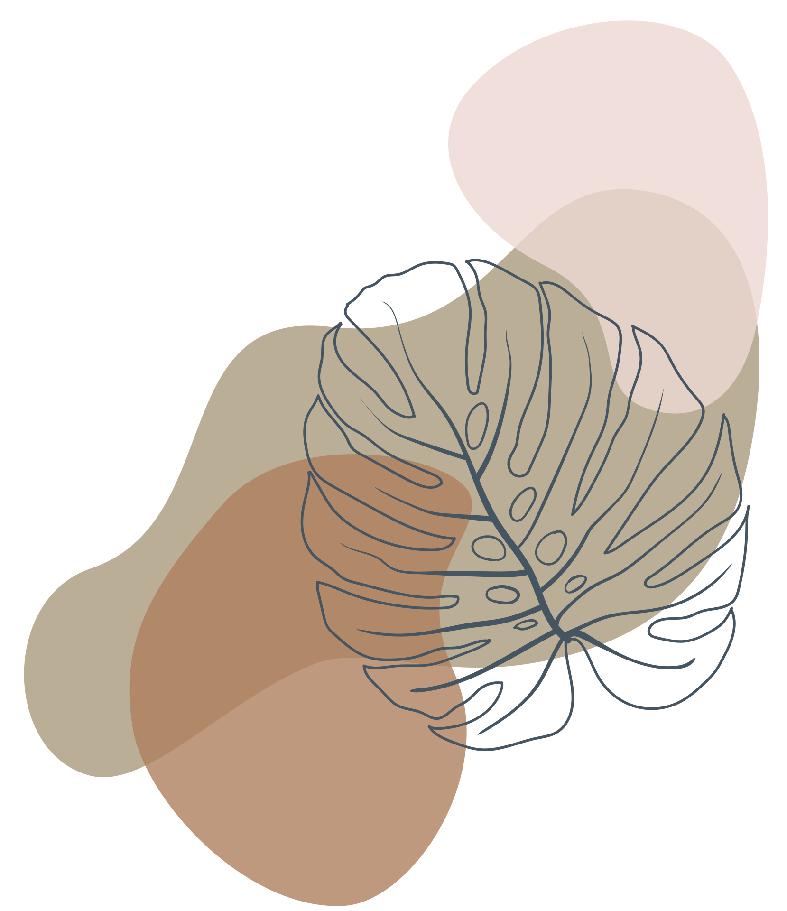
Micro Mouse
Maze Solver

Slide 2
Table of
Content
Components
Algorithms
Simulation
Maze Analysis
Challenges
Team members

Slide 3

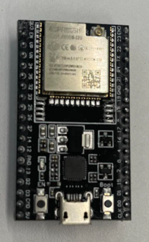
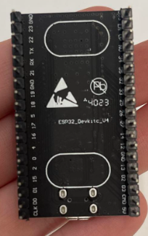
Components
ESP 32
The ESP-32-rom-32-u is the microcontroller used to program and control our mouse. Low power consumption makes it ideal for battery-powered applications. A wide range of peripherals are available, to meet a variety of project requirements.

Slide 4
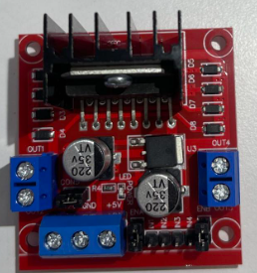
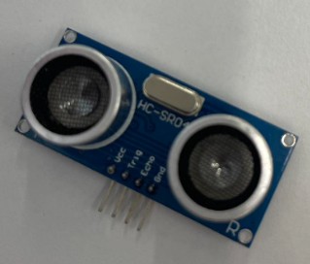
H-Bridage
Ultrasonic Sensor
The H-bridge controlled the speed and direction of both dc motors at the same time.
H-bridge has 7 ports.
The ultrasonic sensor recognizes objects, like walls and barriers using ultrasonic sounds, allowing the robot to move appropriately and avoid colliding. the output is the distance how the object is far

Slide 5
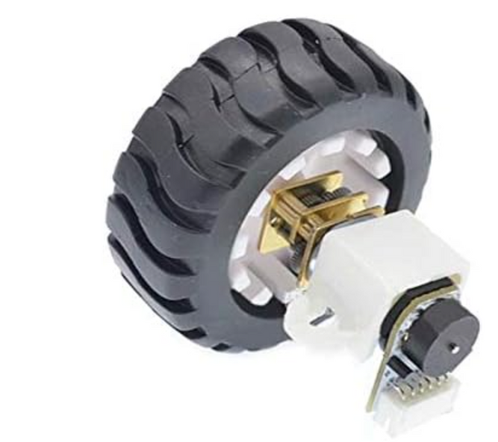
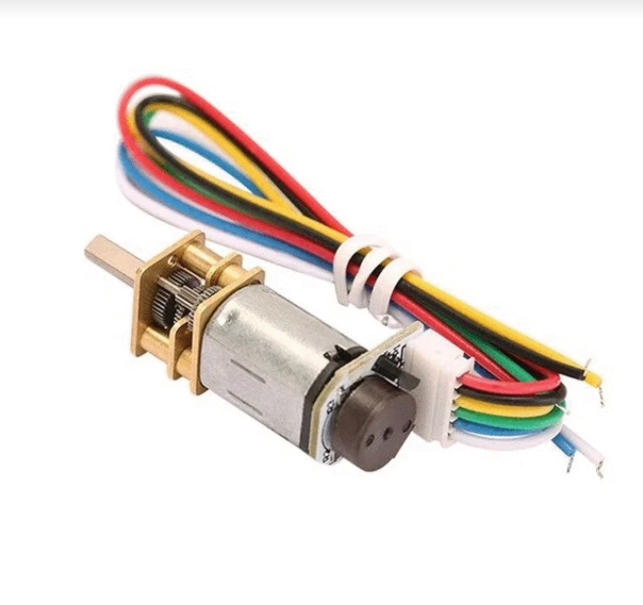

Motors
A 20 DC motor is a direct current (DC) motor of a specified size or power rating, which often indicates its physical dimensions or nominal power output. The "20" marking may represent a specific size category, power rating, or other attributes unique to that motor model.

Slide 6
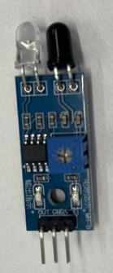
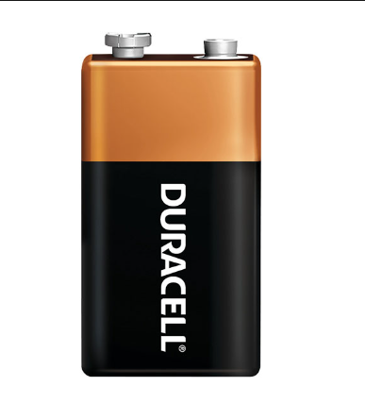
IR Sensor
Battery
The batteries are utilized to provide electricity to the robot. The battery used 9V Alkaline Manganese Dioxide 9 V Battery Non-Rechargeable (Primary)
The IR line track follower detects the closeness of the wall in front of it.
the output is like 0 or depends on the wall closeness.

Slide 7
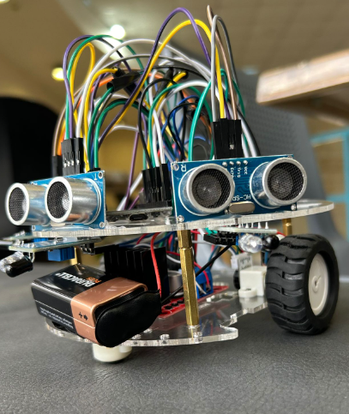

Meet Our Mouse
Jerry

Slide 8
Algorithems
Left Hand Rule
FloodFill
The Left Hand Rule is a simple maze-solving approach that requires the robot to continually follow the maze's left-hand wall. The robot systematically searches the maze, turning left at every crossing until it reaches the destination or completes it. This approach will discover a solution in a simple connected maze, but it may fail in more complex layouts with loops or disconnected paths.
The Flood Fill Algorithm is a labyrinth-solving strategy in which the robot gradually explores the maze by flooding it with numbers denoting the distance from the beginning point. The algorithm begins in the center and gradually grows outward, marking cells with increasing values as it moves through the maze. This process repeats until the target is identified or the entire maze has been investigated.

Slide 9
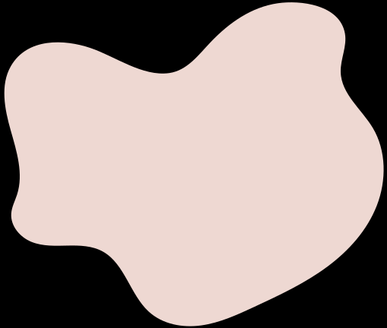
In conclusion, the Left Hand Rule is a simple but somewhat limited technique, whereas flood fill algorithms give a more complicated and adaptive solution for maze-solving in micro mouse robots.

Slide 10
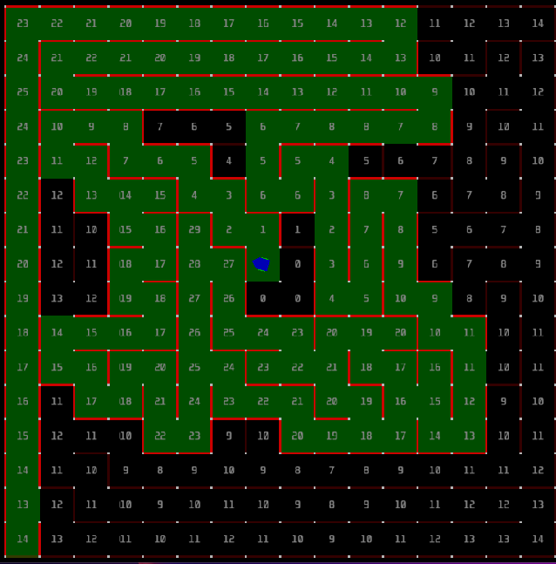
Simulation
We utilized the Python programming language to implement the Flood Fill Algorithm for the MMS simulator. The algorithm assumes that the maze is empty and that the distance to the destination is Manhattan distance. While navigating the maze, the robot visits, if one exists, the lowest neighbor's cost cell and updates the walls surrounding the current cell.
If the robot's costs are less than or equal to those of the neighbors, flood fill must be applied to the remaining neighbors. The current cell is placed in a queue, and if it is visited and has a lower cost than all of its neighbors, its new cost is equal to the lowest of the neighbors plus one, and all of the neighbors are added to the queue.

Slide 11
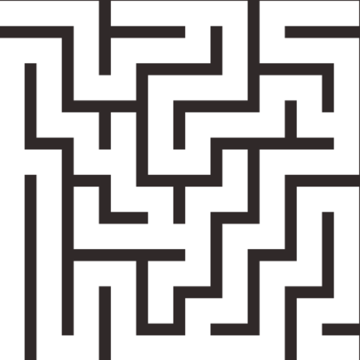
Maze Analysis
Before the robot can successfully navigate a maze, it must first examine its surroundings for any obstacles or dead ends. This information is then used to calculate the layout of the maze as well as the quickest route out. During the maze analysis phase, the robot may use several tactics, such as wall following, sensor data processing, and path planning algorithms. By attentively scrutinizing the maze and making conclusions, the robot can effectively find the solution.

Slide 12

Challanges
During connecting our robot, we faced the following challenges:
Each pin in the ESP was checked independently because we found that some pins don't work despite having ADC.
The robot was walking slowly; at first, we thought that the problem was from the battery, which wasn't strong enough. But after increasing the speed, it worked better.
During testing the robot, we found out that it entered an infinite loop, so we tested each sensor independently and figured out that one of them stopped working after sawing a wall.
Some components don’t fit because of the small space, so we tried many times to change the design to reach the best one that fits the maze.

Slide 13

Lana Batni __ 1200308
Tala Jebrini __ 1200493
Ansam Rihan __ 1200749
Hadeel Froukh __ 1201585

